Slide 1

HEART DISEASE ANALYSIS USING PYTHON

Slide 2

PROBLEM STATEMENT
Heart disease is a leading cause of death worldwide, and early detection is crucial for effective treatment and prevention. In this project, we aim to analyze data related to heart disease to identify patterns and risk factors associated with the disease. The primary objective is to develop a predictive model that can accurately classify individuals as either having heart disease or being healthy based on various clinical and demographic factors.

Slide 3

ABSTRACT
Heart disease is a prevalent and life-threatening condition worldwide, demanding effective diagnostic methods for timely intervention. This project delves into heart disease analysis using Python, focusing on data exploration, feature engineering, and predictive modeling. By harnessing a comprehensive dataset encompassing vital clinical parameters and demographic factors, we endeavor to construct a predictive framework capable of discerning between individuals with and without heart disease. Our methodology integrates Python libraries such as Pandas, NumPy, Matplotlib, Seaborn, and Scikit-learn, facilitating robust data manipulation, visualization, and machine learning model development. Through meticulous analysis, our study sheds light on key determinants of heart disease and underscores the potential of computational approaches in revolutionizing cardiovascular healthcare. This endeavor underscores the significance of data-driven insights in mitigating the burden of heart disease and advancing personalized treatment strategies for improved patient outcomes.

Slide 4
LIBRARIES
Pandas: For data manipulation and preprocessing.
NumPy: For numerical computations and array operations.
Matplotlib and Seaborn: For data visualization.
Scikit-learn: For machine learning model development and evaluation.
Google Colab: For interactive development and documentation.

Slide 5
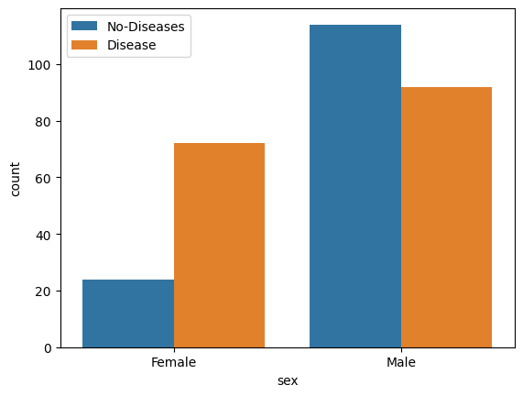
RESULTS
Our data analysis and visualization efforts provided valuable insights into heart disease patterns and risk factors. Through comprehensive exploratory data analysis (EDA), we uncovered notable trends and relationships within the dataset. Visualizations such as histograms, box plots, and correlation matrices enabled us to gain a deeper understanding of the distribution and interplay of clinical and demographic variables in relation to heart disease. Furthermore, visualization techniques facilitated the identification of potential outliers and missing data, guiding our data preprocessing efforts. These visual insights laid the foundation for subsequent machine learning model development, enhancing our ability to construct accurate predictive models for heart disease detection and risk assessment.

Slide 6
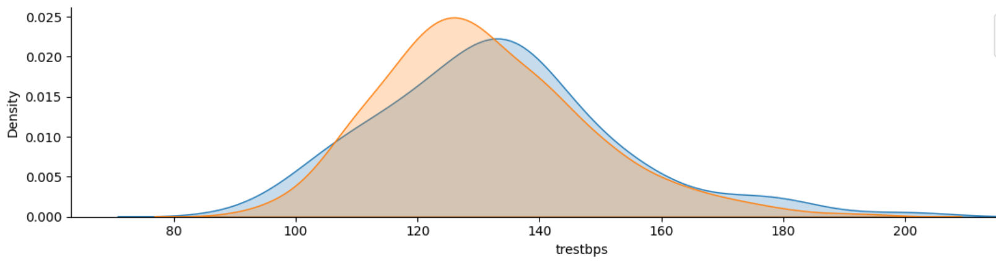

Slide 7
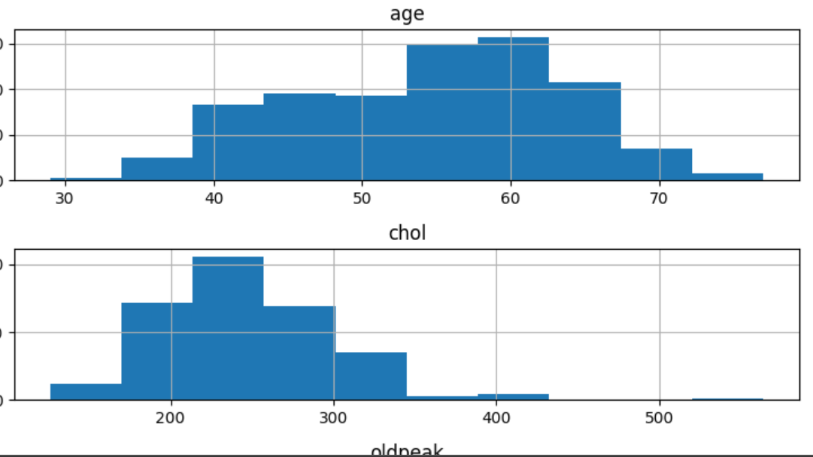

Slide 8
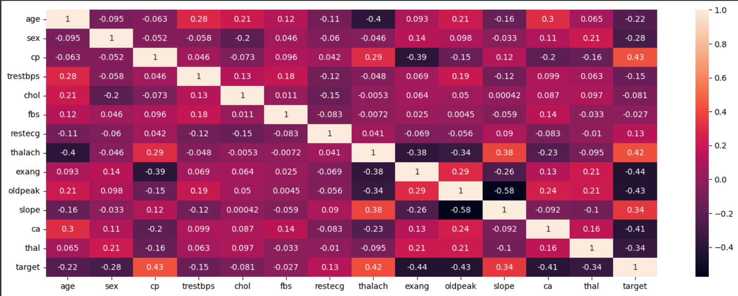

Slide 9
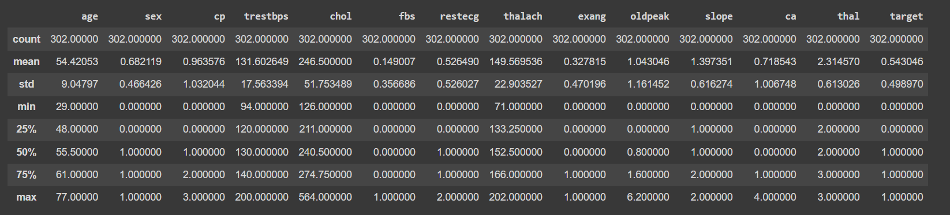

Slide 10

CONCLUSION
Our endeavor to analyze heart disease data using Python for data analysis and visualization has provided valuable insights and contributed to the advancement of cardiovascular healthcare. Through rigorous data exploration and visualization, we gained a comprehensive understanding of the underlying patterns and relationships within the dataset. This exploration illuminated key risk factors and biomarkers associated with heart disease, empowering healthcare practitioners with actionable insights for early detection and intervention.
The utilization of Python libraries such as Pandas, NumPy, Matplotlib, and Seaborn facilitated efficient data manipulation and visualization, enabling us to extract meaningful insights from complex datasets. Leveraging these libraries, we identified significant correlations between demographic factors, clinical indicators, and the prevalence of heart disease, thereby aiding in the development of targeted intervention strategies.

